Slide 1
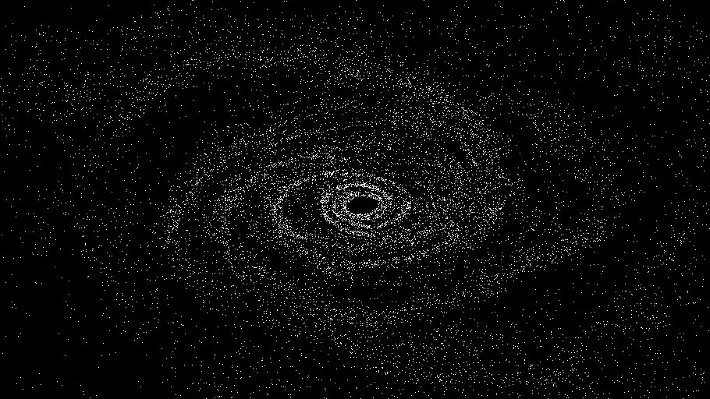
N-Body Simulator

Slide 2
Barnes-hut algorithm

Slide 3
Problem

Slide 4
Technologies
Aside: I first use the SFML Circle Shape for rendering the bodies. I could only get to about 10000 bodies with all optimizations. I then switched to SFML vertexs which are single points and I can do about 30,000.

Slide 5
Barnes-hut algorithm

Slide 6
data flow (per time-step)

Slide 7
Future Improvements
Optimizing for cache and simd
Currently, all Body objects are stored in a single vector using an Array of Structures (AoS) approach.
During simulation, forces are computed by iterating over each Body, accessing its individual properties like, position, mass, and velocity.
This is a classic example where Structure of Arrays (SoA) is a significantly better fit:
By separating characteristics into their own dedicated vectors, we improve cache locality.
This design would also be a perfect setup for using SIMD optimization.
Optimizing rendering
During each iteration loop of the simulation, SFML must redraw every single sf::CircleShape representing a body in the system. Each shape requires a separate draw call, which becomes increasingly costly as N increases.
We can use a sf::VertexArray and represent the bodies as a simple point sprite. This reduces the number of draw calls to one per iteration.
SFML will try to draw all shapes, even those whom have left the view of the window.
We can use culling to skip drawing bodies outside the FOV.

